Slide 1
Scrum and Kanban

Slide 2
Principles of Scrum
Transparency
Inspection
Adaptation

Slide 3
Scrum Roles
No one is in charge – so you have to be accountable for your own piece of the world
Scrum Master
Product Owner
Development team – everyone else

Slide 4
What does the Scrum Master do?
Schedule and facilitate meetings
Train others
Remove blockers and external distractions

Slide 5
What does the Product Owner do?
Voice of the customer
Domain expert
Creates tasks
Prioritizes the backlog
Schedules releases
Communicates progress

Slide 6
User Stories
Who is the work for and how does it benefit them?
Example
As an instructor, I need a way to see all help requests.

Slide 7
Story Points
A way to estimate the package of work that is required to complete a task
It’s about the complexity of the task, not the amount of time it will take

Slide 8
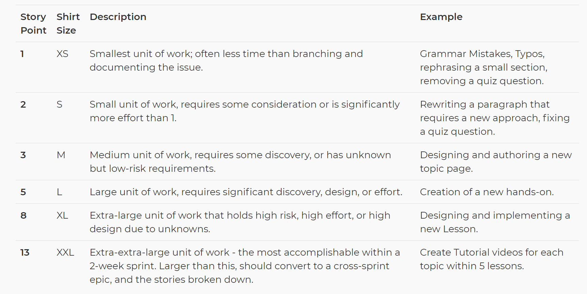
Pointing Tickets with the Fibonacci Sequence

Slide 9
Pillars of Kanban
Visualize what you do
Limit the work-in-progress
Enhance flow
Continuous improvement

Slide 10
Scrum vs. Kanban
Scrum
Kanban
Defined roles
Uses sprints
Batch work
No defined roles
Continuous delivery of work
Better for high variability in priority
Limit the “in progress” work

Slide 11
Swim Lanes / Kanban Boards
To Do
Doing
Done

